Slide 1


Slide 2


Social Buy
SOCIAL ECOMMERCE NETWORK

Slide 3
Members
Du Cam Hong
Developer, UX Designer
Vuong Thanh Phong
Developer, Tester
Duong Minh Hoang
Developer, Tester
Supervised under
Prof. Nguyen Huy Hung

Slide 4
content
Part 1
Background
Part 2
Business Analysis
Part 3
Future Expansion
Part 4
Demonstration

Slide 5

Backgrounds
One of the Internet evolution has made?
That’s the E-Commerce.
E-Commerce changes the way of how we buy & sell.

Slide 6


Backgrounds
Got that.
Make the payment via PayPal, and pick it up at your front door.
Buyer and Seller can find each other easily in a flatten world. Transaction can be made Over The Air.

Slide 7
Backgrounds
However,

Slide 8
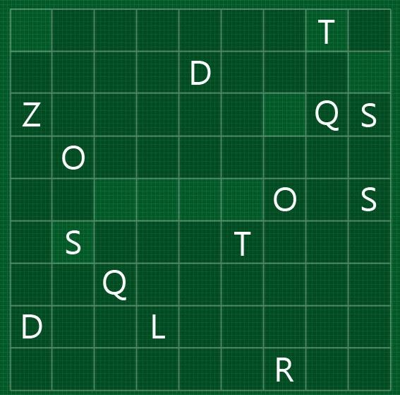
Backgrounds
Lack of Understanding between Buyer and Seller

Slide 9


Backgrounds
Oh, I’m opening a Store online. But… where are the customers?!
Small business and store owner pay less attention to marketing.

Slide 10

Backgrounds
Lack of Cohesion between Buyer and Seller

Slide 11












Ecommerce with fresh experience, integrating social-network-related features.

Slide 12
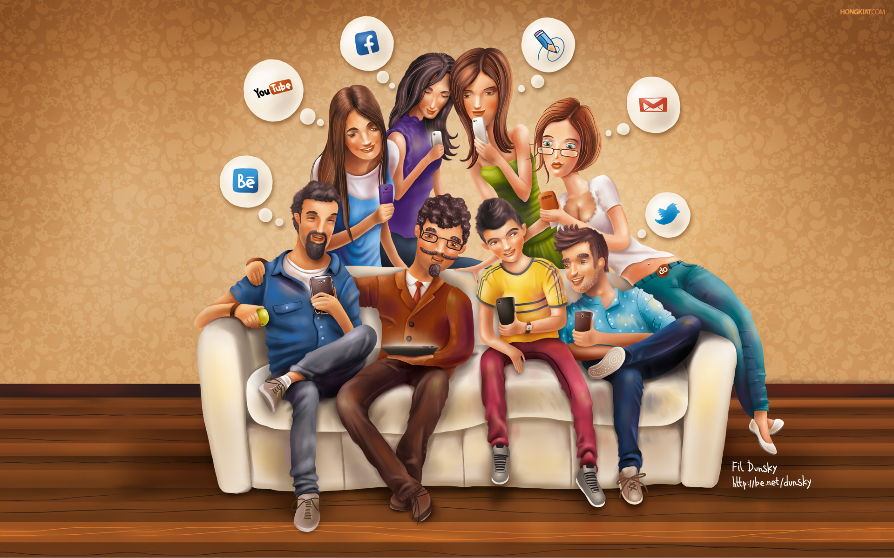
backgrounds
Then, why social ecommerce works?

Slide 13


Why social network works?
90%
of purchases are subject to some kind of social influence
Should I buy a Mac or an Envy 15?
78%
A Mac would be great.
Oh. That’s great. Thanks!!!
of online shoppers use Reviews to make a purchase decision
Source: Inside Facebook, 2011
Notes:
90% quyet dinh mua hang chiu anh huong cua nhung nhan to xa hoi

Slide 14
Benefits for users
Shop Online
Catch up, Follow, Collect and Share
the latest trends, favorites, and people
Interact with Store Merchants,
to be better served

Slide 15

Benefits for business
By collecting, observing customer activities, I have information for business strategies.
More Information, Better Insight

Slide 16

Benefits for business
The marketers calls it “Word of mouth”
Popularity: Be Better Known

Slide 17

Benefits for business
Hey, see? I got mails from customers. I’m building relationship with them now.
Interaction: Building Customer Relationship

Slide 18
backgrounds
How brilliant the picture can be?

Slide 19

How brilliant the picture can be?
Mark Zuckerberg
If I had to guess, social commerce is the next area to really blow up.

Slide 20
Source: Booz & Company, 2012

Slide 21
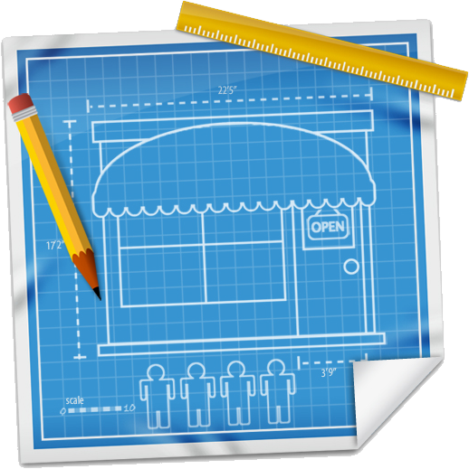
features
How does SocialBuy works?

Slide 22


flows
HOME
STORE
Browse Product
View Information
PRODUCT
View Product details
Recommendations
Comment
USER
View Profile
Follow a User
Like
Follow
1
Share
Follow
1
Add to Cart
1
Track Order
Checkout
Order Mgnt
Open Store
UPGRADE
+ Product

Slide 23







technology
Server side
Client side

Slide 24
Future expansion
Scalability
Information Analysis,
Insight on trends, consumer behaviors…
From Freemium
to Premium

Slide 25
Thank you for your attention

